Slide 1
Introduction of Processes
Operating Systems

Slide 2
Processes
Multiprogramming operating systems are built around the concept of process (also called task).
A given program, or part of program, can be traversed by several processes, simultaneously or sequentially.
Two users could run the same email program at the same time
two processes
same code
different data
could share the same copy of the code
but individual context.

Slide 3
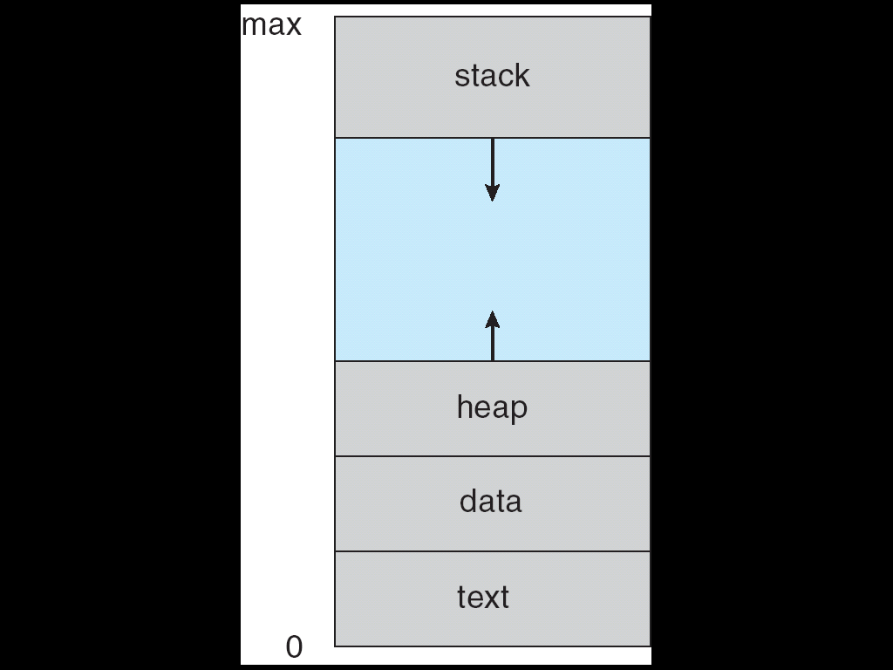
Processes
An operating system executes a variety of programs:
Batch system – Jobs
Time-shared systems – user programs or tasks
Process – a program in some state of execution; process execution must progress in sequential fashion.
A process includes:
The program code, also called text section
Current activity including program counter, processor registers
Stack containing temporary data
Function parameters, return addresses, local variables
Data section containing global variables
Heap containing memory dynamically allocated during run time

Slide 4
Processes
Processes in Memory
What is in memory.
Program to process.
main; a = 2
Stack
What we wrote
X; b = 2
void X (int b) {
if(b == 1) {
…
int main() {
int a = 2;
X(a);
}
Heap
void X (int b) {
if(b == 1) {
…
int main() {
int a = 2;
X(a);
}
What must the OS track for a process?
Code

Slide 5
Processes
Process Concept
Program is passive entity stored on disk (executable file), process is active
Program becomes process when executable file loaded into memory
Execution of program started via GUI mouse clicks, command line entry of its name, etc.
One program can be several processes
Consider multiple users executing the same program

Slide 6
Processes
OS Support for Processes
OS must interleave the execution of several processes to maximize CPU usage while providing reasonable response time
OS must allocate resources to processes
and avoid deadlock and starvation
OS must support inter-process communication and user creation of processes

Slide 7
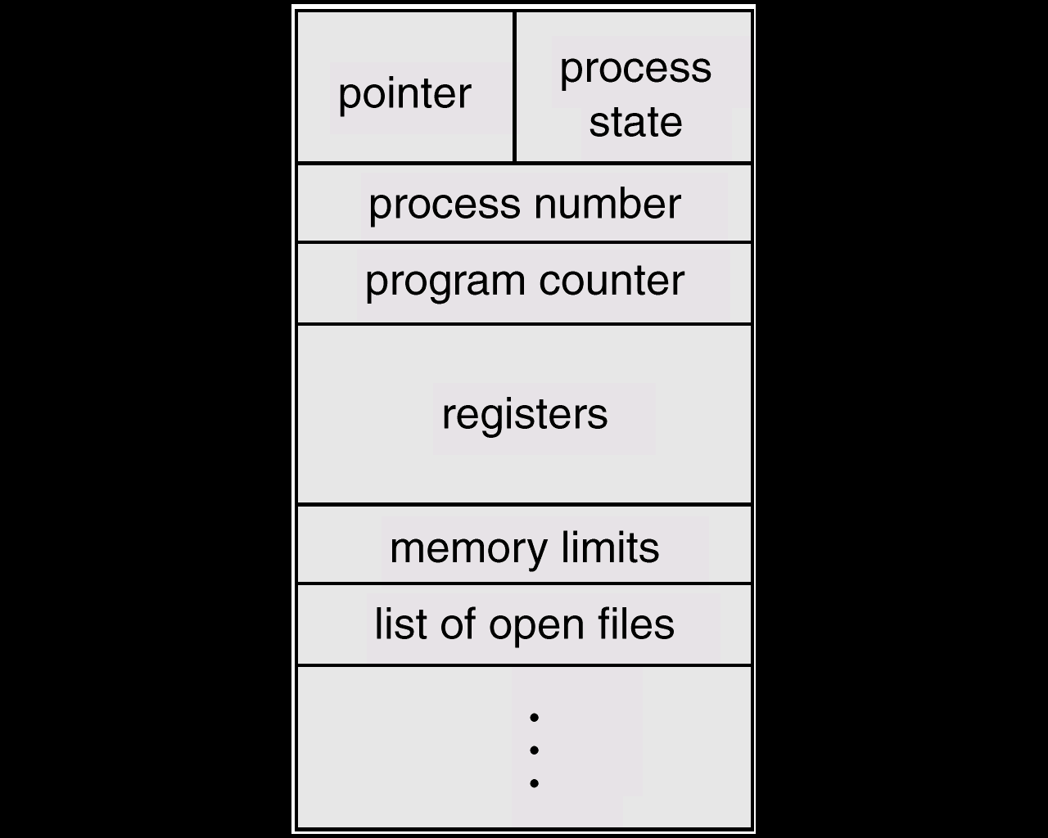
Processes
Process Control Block(PCB)
The Operating Systems keeps track of each process using a Process Control Block
Information associated with each process – uniquely identifies and characterizes a particular process.
Some information in the PCB:
Process state – running, waiting, ready, etc.
Program counter
CPU register values
CPU scheduling information - used by short term scheduler
Memory-management information – base, limit registers, page table info, etc.
Accounting information
I/O status & file information – devices allocated to proc., open files, etc.

Slide 8
Processes
Process Control Block (PCB) Other Information
Interprocess Communication
may hold flags and signals for IPC
Process Privileges
access to certain memory locations...
Memory management
pointers to segment/page tables assigned to this process
Resource ownership and utilization
resources in use: open files, I/O devices...
history of usage (of CPU time, I/O...)

Slide 9
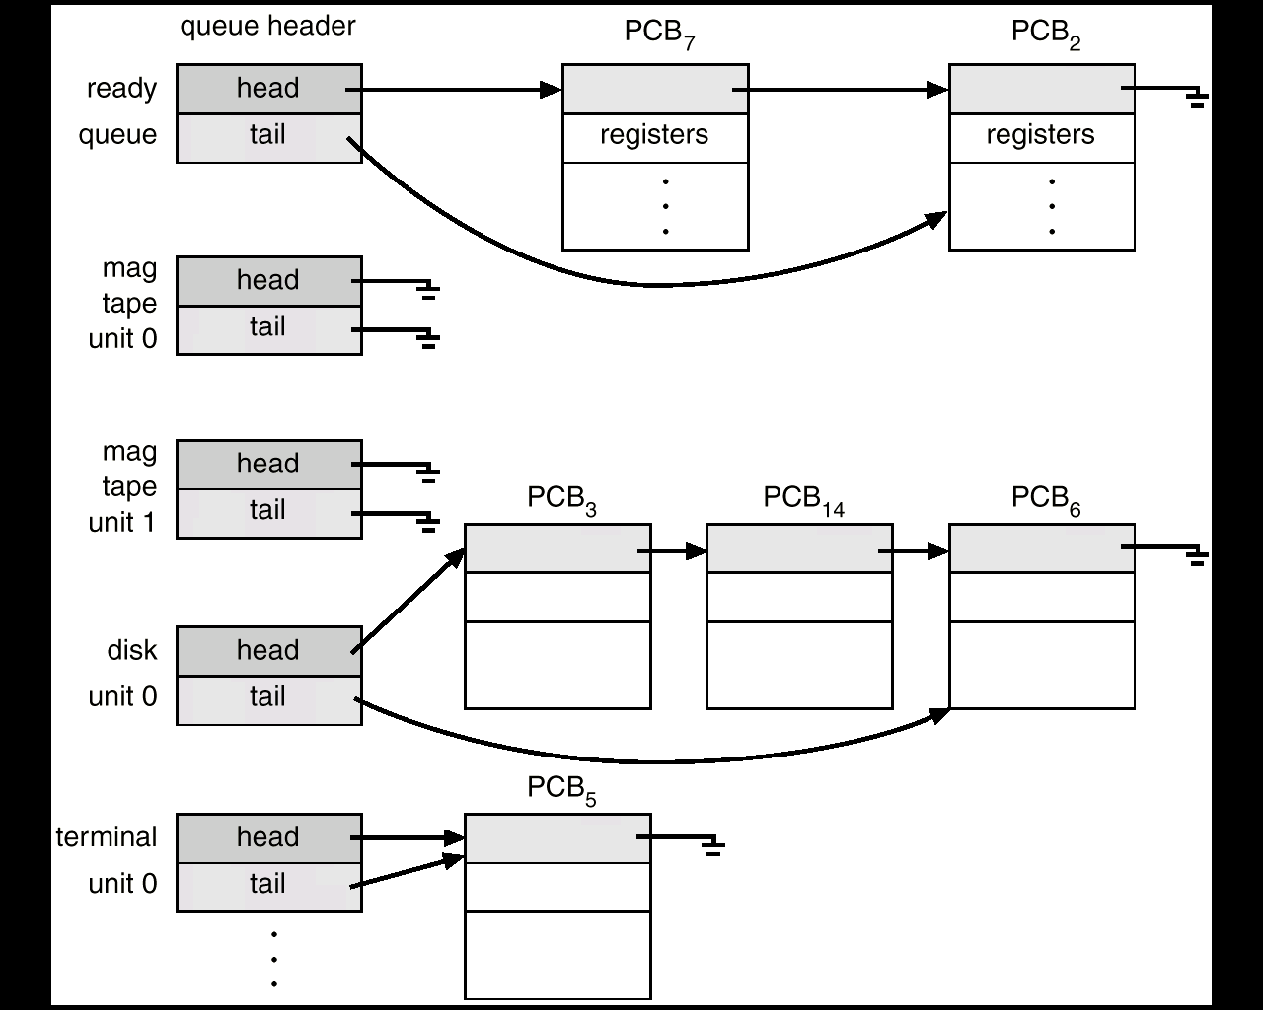
Processes
Queues as linked lists of PCBs

Slide 10
Processes
Creation of a Process
Assign a unique process identifier (pid)
Allocate space for the process image
code, data, stacks
Initialize process control block
usually default values (State = New, no I/O devices or files...)
Set up appropriate linkages
Add new PCB to linked list used for the scheduling queue (probably the “NEW” queue)

Slide 11
Processes
When does a process get created?
Submission of a batch Job
User logs on
Created by OS to provide a service to a user (ex: printing a file)
Spawned by an existing process
user programs can create one or more processes during execution
The new process is called the “child” and the process that spawned it is called the “parent”

Slide 12
Processes
When does a process get terminated?
Batch Job issues Halt instruction
User logs off
Process executes a service request to terminate
Error or fault conditions

Slide 13
Processes
Reasons for Process Termination
Normal completion
Time limit exceeded
Memory unavailable
Memory bounds violation
Protection error
example: write to read-only file
Arithmetic error
Timeout
process waited longer than a specified maximum for an event

Slide 14
Processes
Reasons for Process Termination
I/O failure
Invalid instruction
happens when try to execute data
Privileged instruction
Operating system intervention
such as when deadlock occurs
Parent request to terminate child
Parent terminates so child processes terminate automatically
Etc.

Slide 15
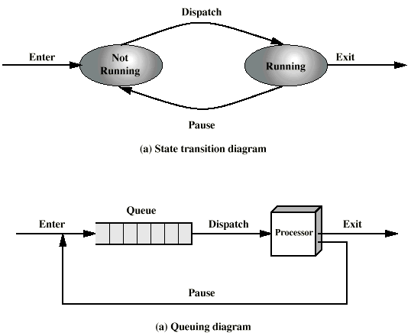
Processes
Simple State Model
Suppose we have a list of active processes and a dispatcher that regularly pauses (interrupts) the active process and selects the next process from a list to get a “turn” (this is “round robin” scheduling)
We can view this with a simple two-state process model

Slide 16
Processes
Limitations to Two-State Model
Two states is enough to handle processes that are always ready to execute
In reality, processes are often “blocked” waiting for the completion of some I/O or other operation
The dispatcher can only restart processes that are really “ready” to run again
We need a more realistic process model
For simplicity, assume there is only one processor, so only one process can be running at a time.
(With “symmetric multiprocessing”, one process can be running on each CPU)

Slide 17
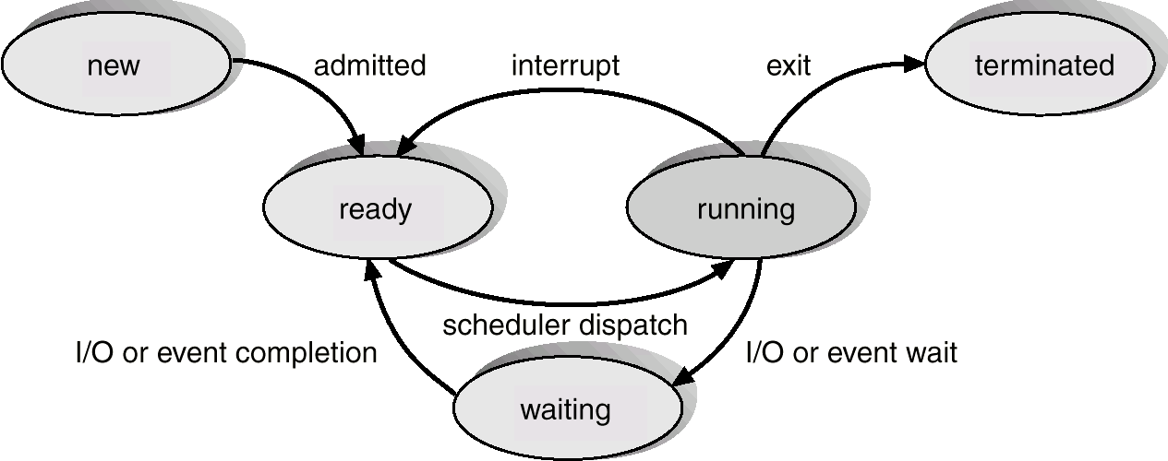
Processes
A Five-State Process Model
As a process executes, it changes state to
new: The process is being created.
running: Instructions are being executed.
waiting: The process is waiting for some event to occur.
ready: The process is waiting to be assigned to a processor – not waiting for anything or resource.
terminated: The process has finished execution.

Slide 18
Processes
Process Transitions
Ready --> Running
The dispatcher selects a new process to run (scheduling problem).
Running --> Ready
the running process has used its maximum “time slice” (most OS’s do this)
the running process is preempted by a higher priority process which is in the ready state
..if the OS supports process priorities
Running --> Waiting(Blocked)
When a process requests something for which it must wait
a service of the OS that requires a wait
initiates I/O and must wait for the result
an access to a resource not yet available
waiting for a process to provide input (IPC)
Waiting(Blocked) --> Ready
When the event for which it was waiting occurs
One more case:
Ready --> Exit: For example, parent terminates a child process
Child removed directly from Ready queue

Slide 19
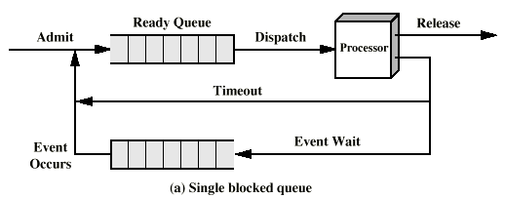
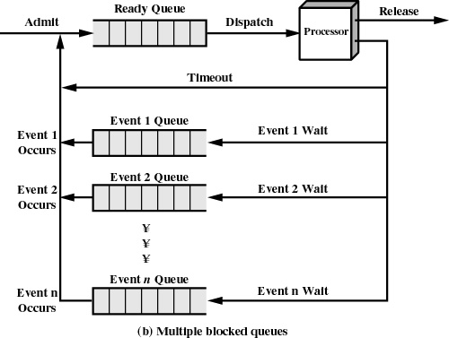
Processes
Queuing representation of Process States
When a particular event occurs, the scheduler must scan the entire blocked queue looking for processes waiting for that particular event
One queue for each event
When event n occurs, all processes in queue “n” are moved to the ready queue

Slide 20
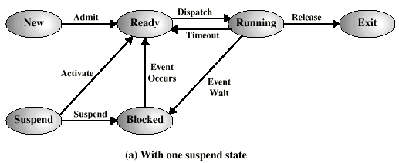
Processes
The Need for Swapping
We have assumed that all processes have space allocated in main memory
Even with virtual memory, too many processes in main memory deteriorates system performance
Sometimes there will be no processes in the Ready state, because they are all blocked
So the OS could suspend one of these blocked processes: swap it out to auxiliary memory (disk).
And the OS can admit, or activate either a new process, or one that was swapped out earlier
So we will add a Suspend state, for those processes swapped out of memory

Slide 21
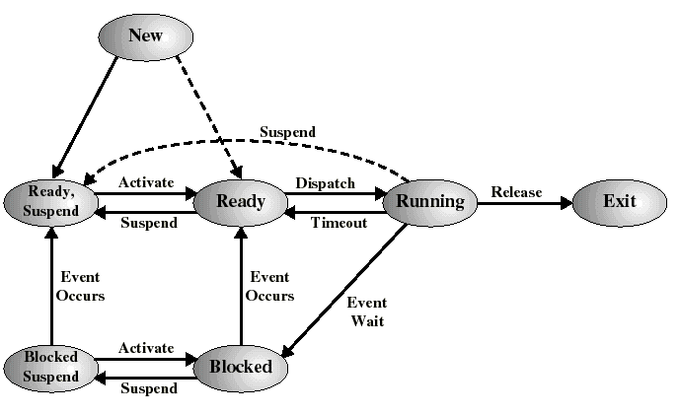
Processes
A Seven-State Process Model
But it is better to add two states to keep track of those that are still blocked, and those which are no longer blocked because their event has occurred..

Slide 22
Processes
Some New State Transitions
Blocked --> Blocked Suspend
When all processes are blocked, the OS may remove a blocked process to bring an unblocked process into memory
The “swap out” frees up memory to allow this to happen
Blocked Suspend --> Ready Suspend
When the event for which process has been waiting occurs
Ready Suspend --> Ready
When there are no ready processes in main memory
Normally, this transition is paired with Blocked --> Blocked suspend for another process (a “swap”)
Ready--> Ready Suspend
When there are no blocked processes and must free up memory for performance reasons
New--> Ready Suspend
Probably the preferred way to introduce new processes

Slide 23
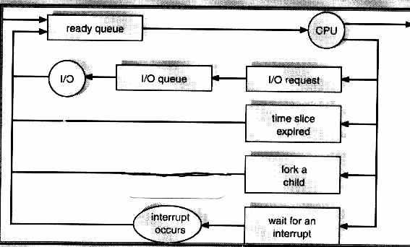
Processes
Process Scheduling Queues
Process queue – set of all processes in the system.
Ready queue – set of all processes residing in main memory, ready and waiting to execute.
Device queues – set of processes waiting for an I/O device.
Process migration between the various queues. Elements entered in these queues are PCB’s – linked list

Slide 24
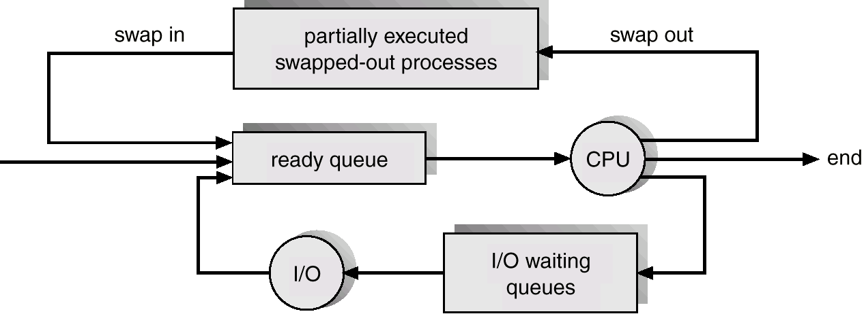
Processes
Schedulers
Long-term scheduler (or Process scheduler) – selects which processes should be brought into the ready queue. Schedule new Program to become a process (from disk)
Short-term scheduler (or CPU scheduler) – selects which process should be executed next and allocates CPU.
Medium term scheduler - remove processes, especially suspended, from memory and move to disk. Later bring process back into memory
Swapping - controls degree of Multiprogramming, and memory utilization
Short-term scheduler is invoked very frequently (milliseconds) ⇒ (must be fast) – a potential performance bottleneck).
Long-term scheduler is invoked very infrequently (seconds, minutes) ⇒ (may be slow).
The long-term & medium term schedulers controls the degree of multiprogramming – how many programs to have in memory at one time.
Has implications on controlling “thrashing” in a Virtual memory system
Processes can be described as either:
I/O-bound process – spends more time doing I/O than computations, many short CPU bursts.
mp3 encoding
Scientific applications (matrix multiplication)
Compile a program or document
CPU-bound process – spends more time doing computations; few very long CPU bursts.
Index a file system
Browse small web pages
Balance process-
Playing video
Moving windows around/fast window updates

Slide 25
Processes
Context Switch
When CPU switches to another process, the system must save the state of the old process and load the saved state for the new process.
Context-switch time is overhead; the system does no useful work while switching– an area needing optimization.
Time dependent on hardware support.
Two Types of Context Switch
Simple Mode Switch to process an interrupt without switching processes: user process is suspended but will be resumed immediately:
only save what is necessary to resume execution of the same process (e.g. program counter, couple of registers)
Full Process Switch: process is suspended and another process will get the CPU:
save entire context into PCB, load new context from other PCB, update process state.
A “heavier duty” operation

Slide 26
Processes
Steps for Full Process Switch
Save context of CPU including program counter and other registers
Update the PCB of the running process with its new state and other info
Move PCB to appropriate queue
Ready, Blocked, etc.
Select another process for execution
Update PCB of the selected process
Running
Restore CPU context from PCB of the selected process

Slide 27
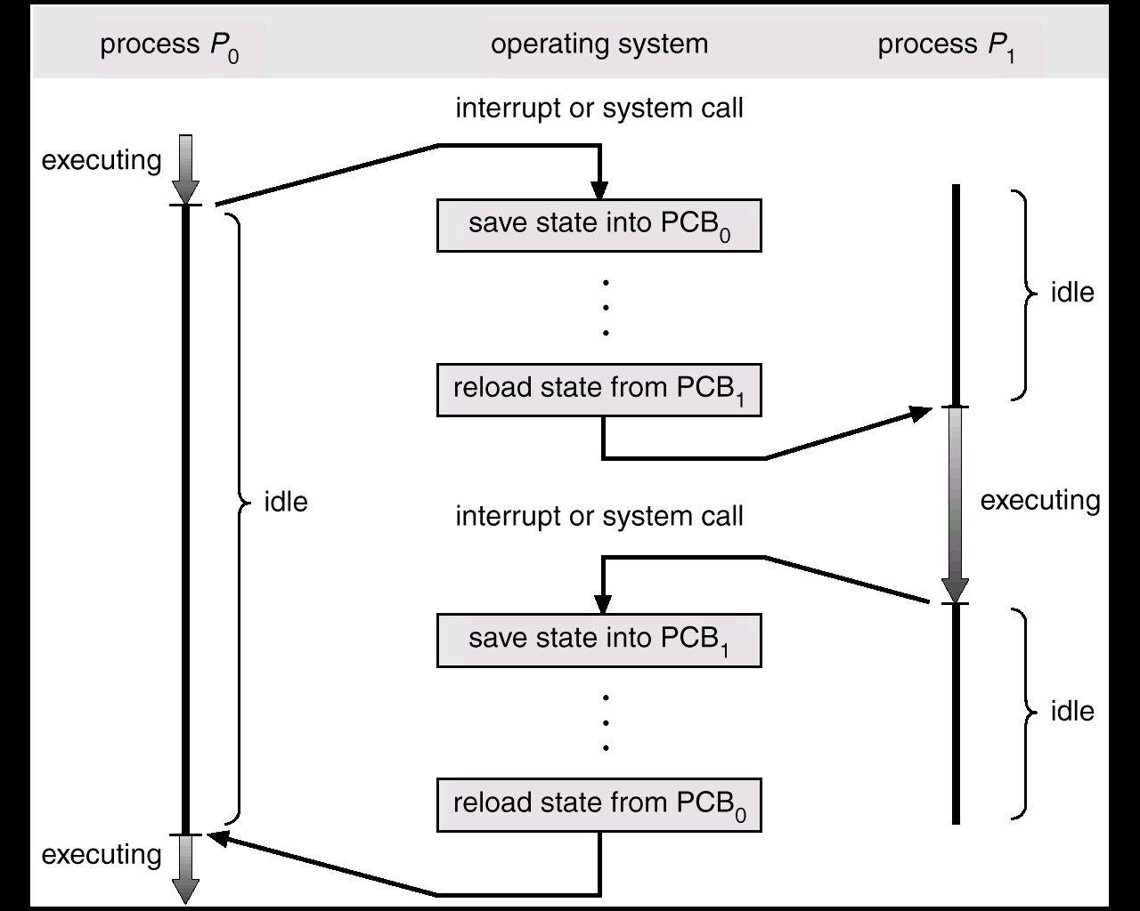
Processes
CPU Switch From Process to Process

Slide 28
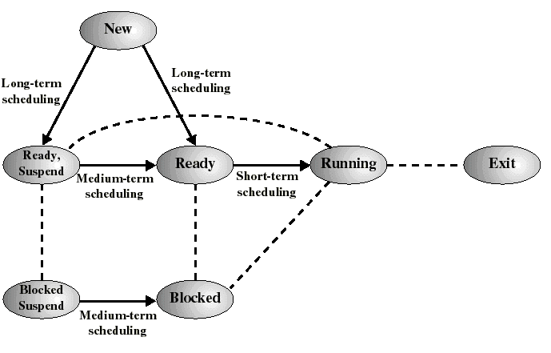
Processes
Classification of Scheduling Activity
Long-term: which process to admit
Medium-term: which process to swap in or out
Short-term: which ready process to execute next

Slide 29
Processes
Queuing Diagram for Scheduling
Long-term
scheduling
Time-out
Batch
Ps
Ready Queue
Short-term
scheduling
Release
Processor
Medium-term
scheduling
Interactive
users
Ready, Suspend Queue
Medium-term
scheduling
Blocked, Suspend Queue
Blocked Queue
Event Wait
Event
Occurs

Slide 30
Processes
Long Term Scheduling
Determines which programs are admitted to the system for processing
Controls the degree of multiprogramming
If more processes are admitted
less likely that all processes will be blocked
better CPU usage
each process has smaller fraction of the CPU
The long term scheduler may attempt to keep a mix of processor-bound and I/O-bound processes

Slide 31
Processes
Medium-Term Scheduling
Swapping decisions based on the need to manage multiprogramming
Allows the long-term scheduler to admit more processes than actually fit in memory
but too many processes can increase disk activity (paging), so there is some “optimum” level of multiprogramming.
Done by memory management software

Slide 32
Processes
Short-Term Scheduling
Determines which process is going to execute next (also called CPU scheduling)
invoked on an event that may lead to choosing another process for execution:
Clock interrupts
I/O interrupts
Operating system calls and traps, including I/O
Signals

Slide 33
Bibliography
Silberschatz, A, Galvin, P.B, and Gagne, G., Operating System Principles, 9e, John Wiley & Sons, 2013.
Stallings W., Operating Systems-Internals and Design Principles, 7e, Pearson Education, 2014.
Harvey M. Deital, “Operating System”, Third Edition, Pearson Education, 2013.
Andrew S. Tanenbaum, “Modern Operating Systems”, Second Edition, Pearson Education, 2004.
Gary Nutt, “Operating Systems”, Third Edition, Pearson Education, 2004.

Slide 34
Acknowledgements
I have drawn materials from various sources such as mentioned in bibliography or freely available on Internet to prepare this presentation.
I sincerely acknowledge all sources, their contributions and extend my courtesy to use their contribution and knowledge for educational purpose.

Slide 35
Thank You!!
?

